Slide 1


Titolo presentazione sottotitolo
Data Mining Project
Diego Gaboardi
Danilo Labanca
Riccardo Giol
Emilia Lenzi
Michele Ferri
Politecnico di Milano A.A 2017-2018
Milano, XX mese 20XX

Slide 2
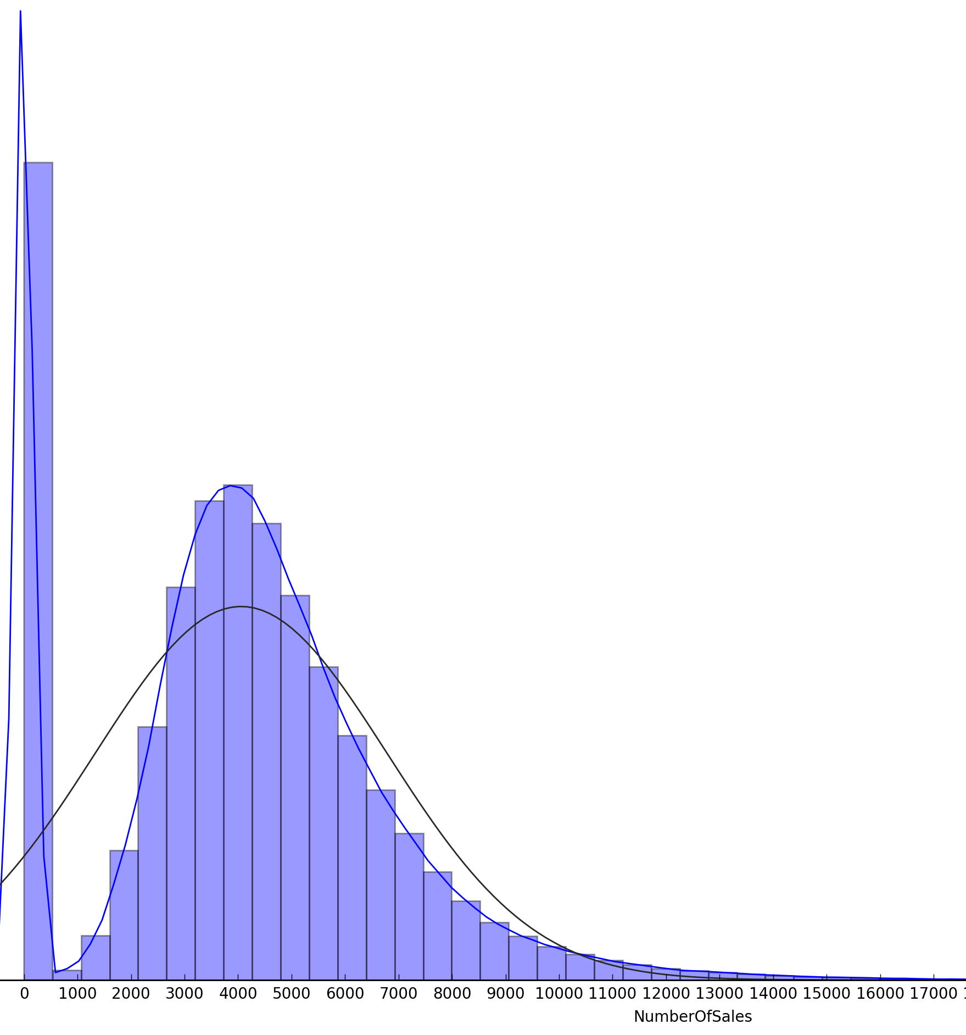
Data Exploration
DATA WITH NUMBER OF SALES
TEST
3/16
3/18
5/18
FEATURES
number of sales
number of visitors
store information
weather information
demographic information
NUMBER OF FEATURE: 36
4 categorical features
32 numerical features
MISSING VALUES
Max_Gust_SpeedKm_h 78%
Events 24%
CloudCover 8%
visibility features 2%
NUMBER OF SALES DISTRIBUTION
High density next to 0 (when the store is closed)
Mean = 4890 - Standard Deviation = 2214
FREQUENCY
NUMBER OF SALES

Slide 3
Preprocessing
New features added (Mean Store Sales, Mean Month Sales, Was Open Yesterday, Is Open Tomorrow…)
Categorical features are transformed to numerical
We filled missing values with a simple linear model that uses the most correlated variable to the one with missing values
New features added (Mean Store Sales, Mean Month Sales, Was Open Yesterday, Is Open Tomorrow…)
Categorical features are transformed to numerical
FEATURES ENGINEERING
MISSING VALUES
OUTLIERS
TRAINING SET
VALIDATION SET
TEST SET
90% of data taken at random
10% of data taken at random
Last 2 month of the dataset

Slide 4
Models Used

Slide 5
Model Evaluation

